Slide 1

Robot Design

Slide 2
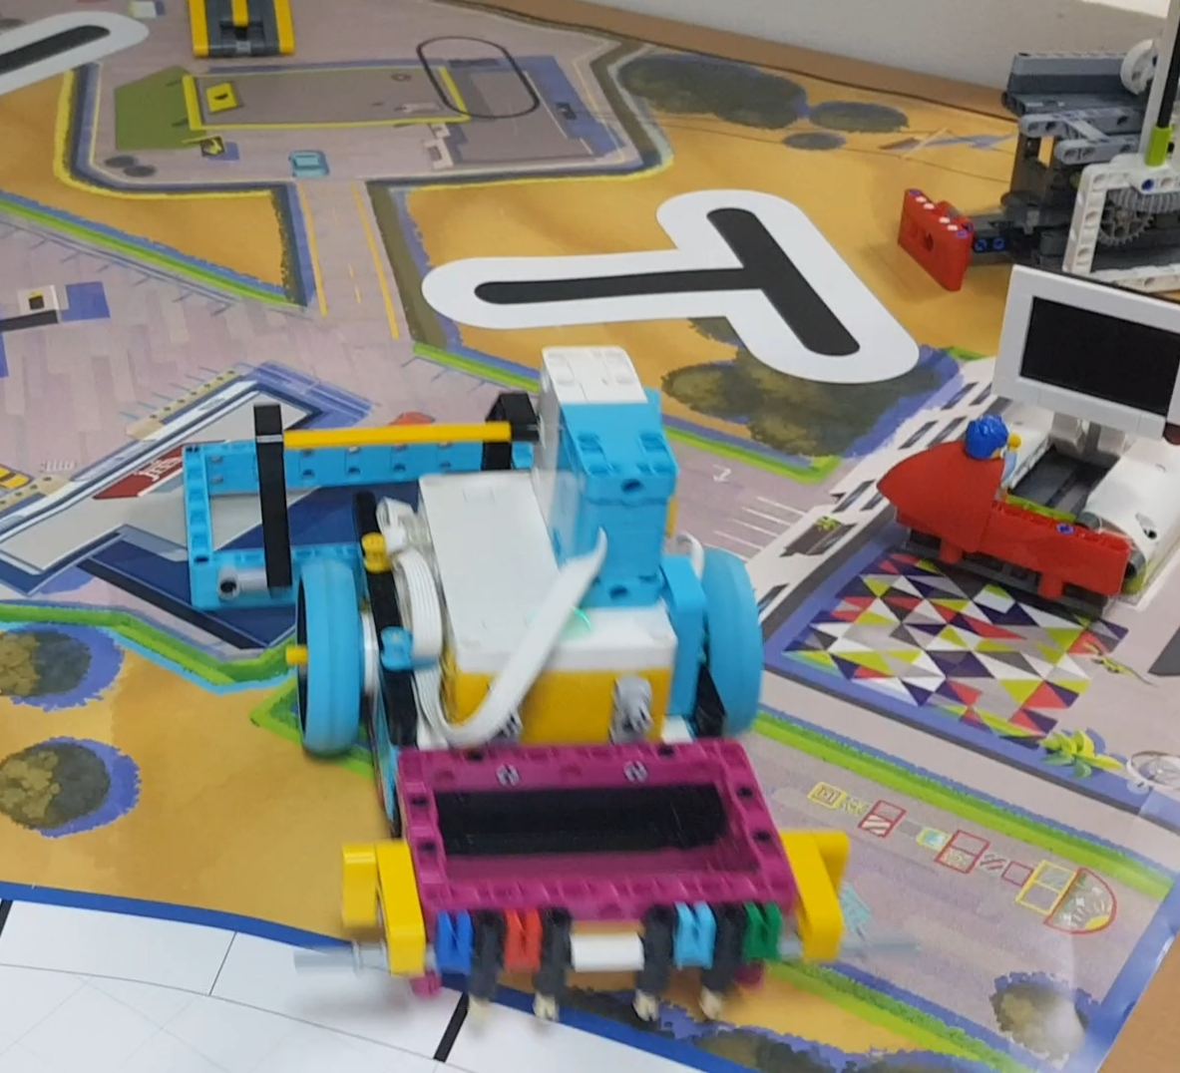
Our robot
Made using the Spike Prime Robot Manual.
Driving Base from spike prime with our own changes.
The attachment motor is above the hub instead of below the hub as it is easier for our attachments to be used.

Slide 3
1st Attachment-moving basket
It is a basket connected to the attachment motor.
It helps us do the windmill mission as it collects the energy units from the windmill.
It also helps us do the rechargeable battery mission as it lifts the basket and releases the energy units.

Slide 4
2nd attachment-THE CILLECTING BASKET
It is a basket that helps us collect the rechargeable battery when moving back after the windmill mission.
The basket captures the energy unit but doesn’t allow it to go out when moving around.
This attachment can also help as in the Smart Grid mission and the Solar farm mission.

